Slide 1
Red tide time series forecasting by combining ARIMA and deep belief network.
Qin M, Li Z, Du Z.
Knowledge-Based Systems, 2017, 125: 39-52.

Slide 2
Introduction
The occurrence of red tide is the result of the mixed effects of biological, chemical, hydrological and meteorological factors.
These factors lead to the seasonal, spatial heterogeneity and complex nonlinear relationship, bringing great challenge to the prediction of red tide in the field of Marine Science.
Existing red tide prediction methods include classification methods (eg. Decision Tree (DT) , fuzzy c-means (FCM)), regression methods (eg. Back Prorogation (BP) neural network, Radial Basis Function (RBF) neural network).

Slide 3
Introduction
In this paper, a novel ARIMA-DBN hybrid model is proposed to predict the possibility of occurrence and the future trends of red tide.
The corresponding ARIMA model is built for each environmental factor in different coastal areas to describe the temporal correlation and spatial heterogeneity.
The DBN serves to capture the complex nonlinear relationship between the environmental factors and the red tide biomass, and then realizes the warning of red tide in advance.

Slide 4
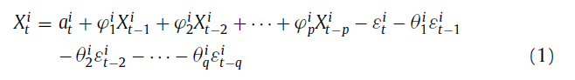
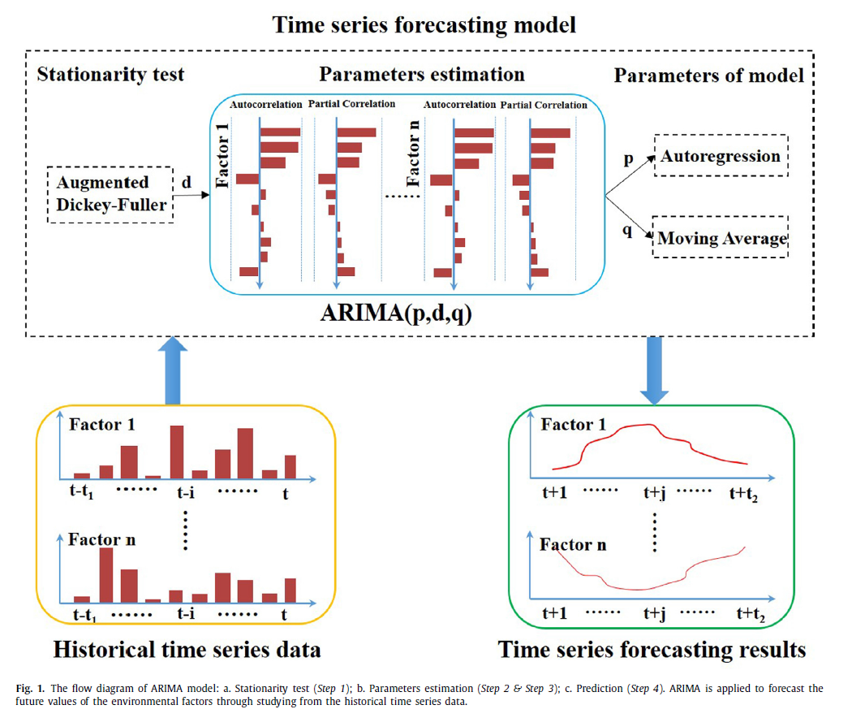
ARIMA(p,d,q)

Slide 5
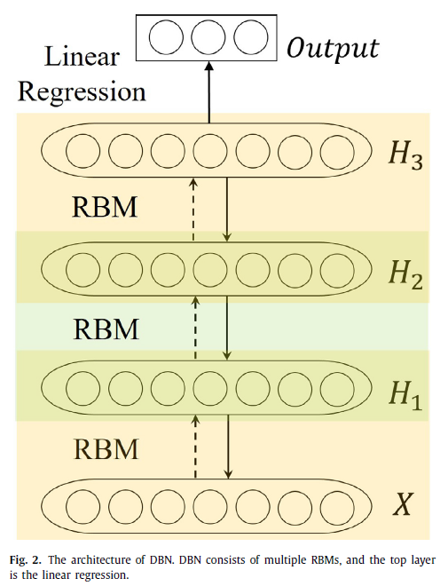
DBN
Step 1: Train the first RBM with the input data x being the visible units.
Step 2: Fix the weights and bias of the first RBM, and the state of the hidden units is used as the input of the second RBM.
Step 3: The second RBM is stacked on the top of the first RBM after training.
Step 4: Iterate (2 and 3) for the desired number of layers, each time propagating upward either samples or mean values.
Step 5: Fine-tune all the parameters in this deep architecture with respect to a proxy for the DBN log-likelihood. In this work, the red tide biomass is continuous, so the fine-tune algorithm of DBN is a linear regression algorithm.

Slide 6
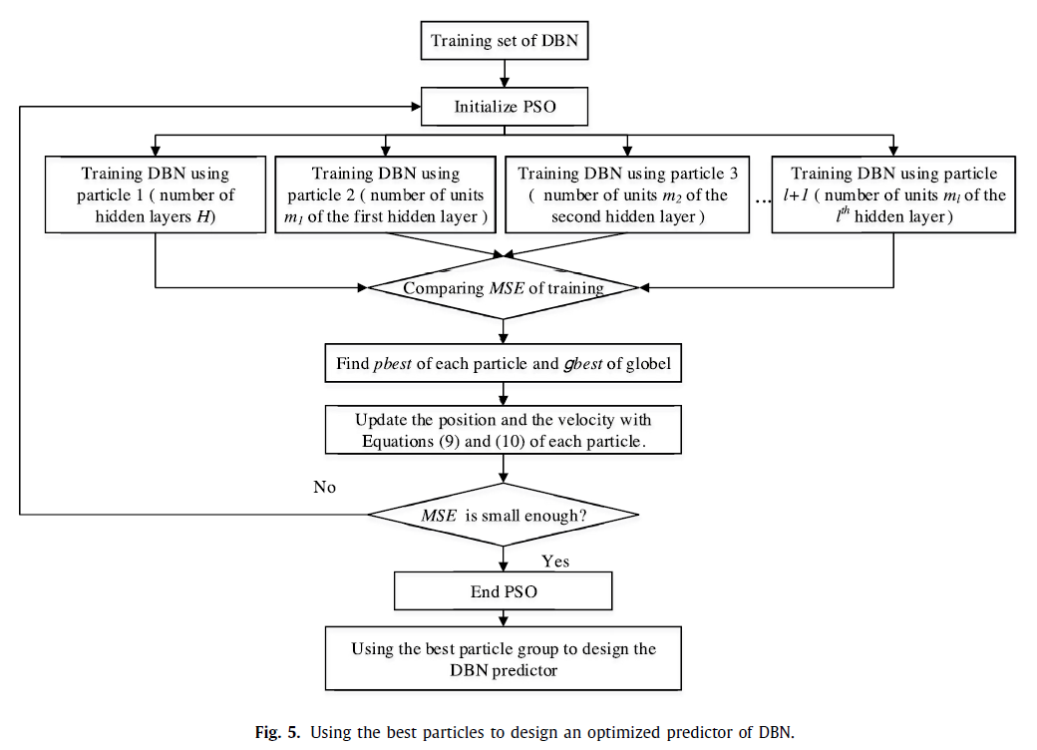
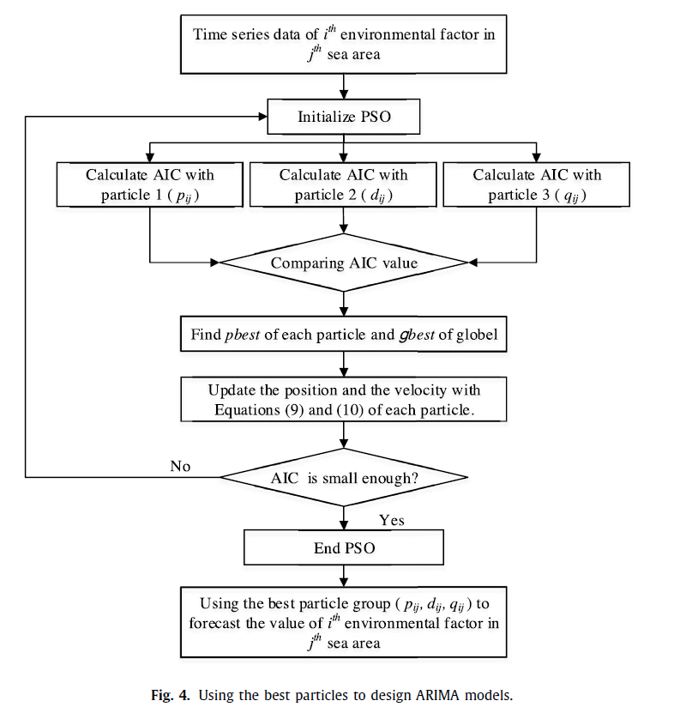
PSO Optimization

Slide 7
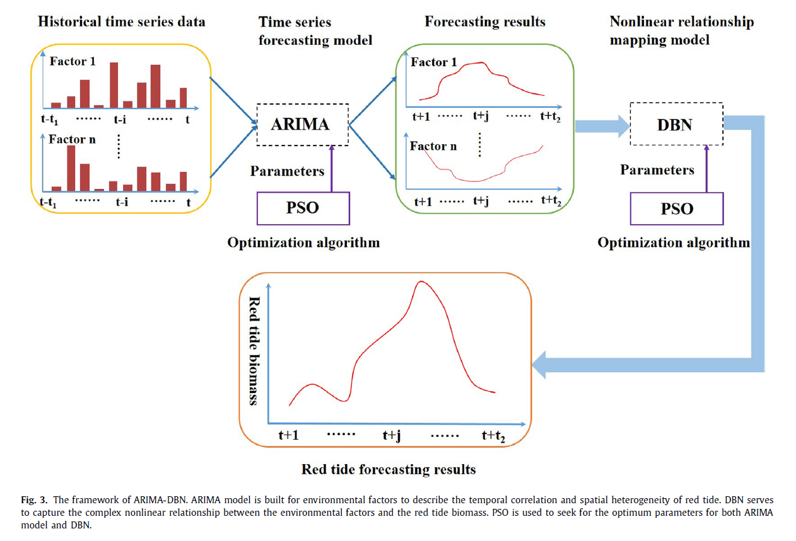
Hybrid Model

Slide 8
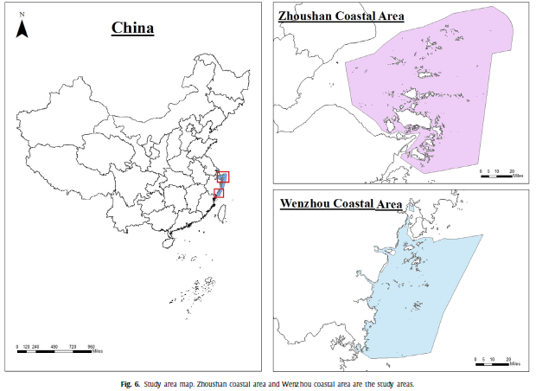
Experiments
Area
Data
A total of 6200 time series data (3800 in Zhoushan and 2400 in Wenzhou) is available in this work.
12个影响因子：ph、溶解氧、溶解氧饱和度、化学需氧量（COD）、温度、叶绿素、磷酸盐、氨氮、硝酸盐、亚硝酸盐、盐度、硅酸盐。

Slide 9
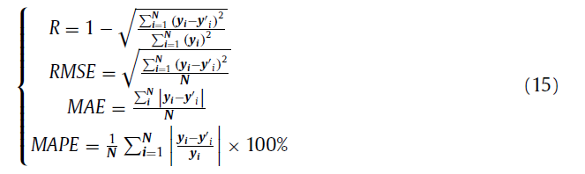
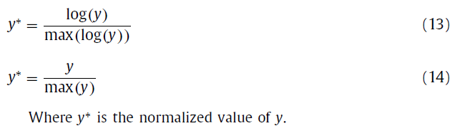
Experiments
Data pre-processing
Evaluation criteria
Owing to the large-range of the red tide biomass in the real scale, which is from 10^2 to 10^7 .
The activation function of DBN is Sigmoid Function, and the range of the function is [0,1].

Slide 10
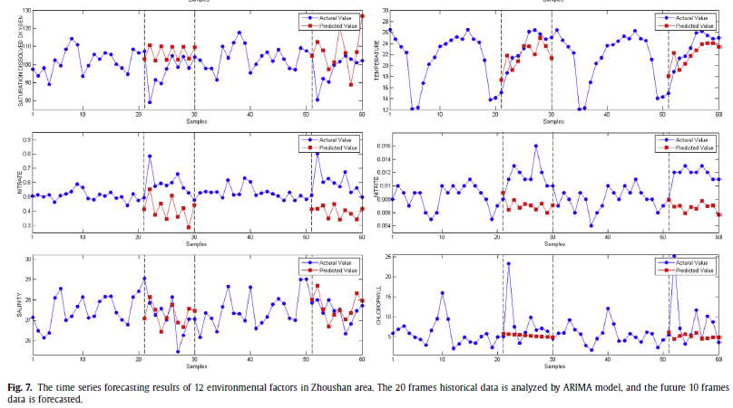
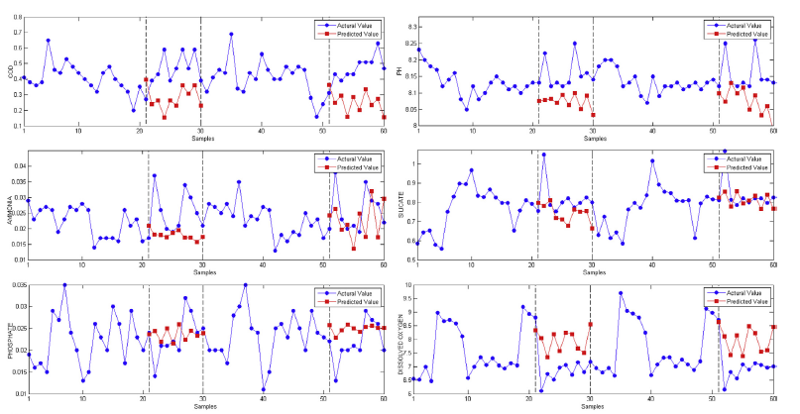
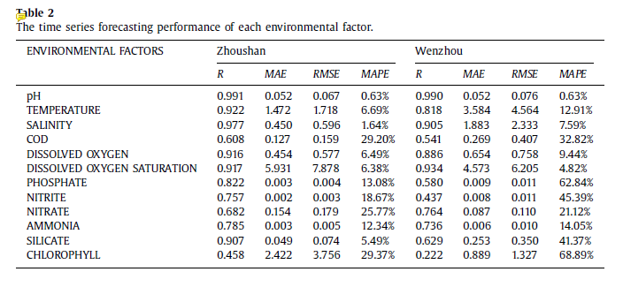
Environmental factors forecasting

Slide 11
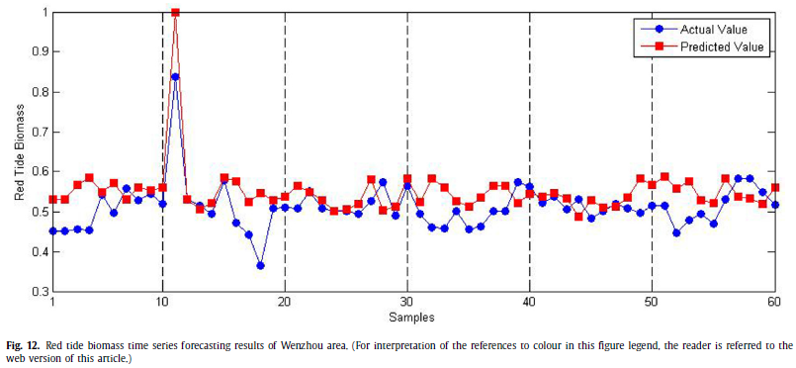
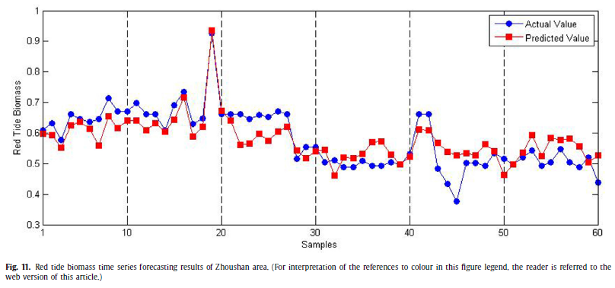
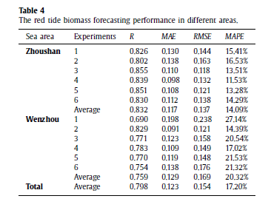
ARIMA-DBN hybrid model

Slide 12
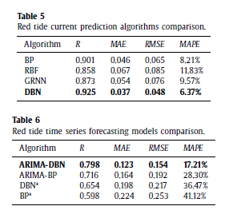
Algorithm comparison

Slide 13
A deep learning framework for financial time series using stacked autoencoders and long-short term memory
Bao W, Yue J, Rao Y.
PloS one, 2017, 12(7): e0180944.

Slide 14
Introduction
Stock market prediction is usually considered as one of the most challenging issues among time series predictions due to its noise and volatile features.
During the past decades, machine learning models, such as Artificial Neural Networks (ANNs) and the Support Vector Regression (SVR) , have been widely used to predict financial time series and gain high predictive accuracy.
Deep nonlinear topology can successfully model complex real-world data by extracting robust features that capture the relevant information and achieve even better performance than before.

Slide 15
Introduction
The proposed model in this paper consists of three parts: wavelet transforms (WT), stacked auto-encoders (SAEs) and long-short term memory (LSTM).
SAEs is the main part of the model and is used to learn the deep features of financial time series in an unsupervised manner.
LSTM it is well-suited to learn from experience to predict time series when there are time steps with arbitrary size.
WT is considered to fix the noise feature of financial time series.

Slide 16
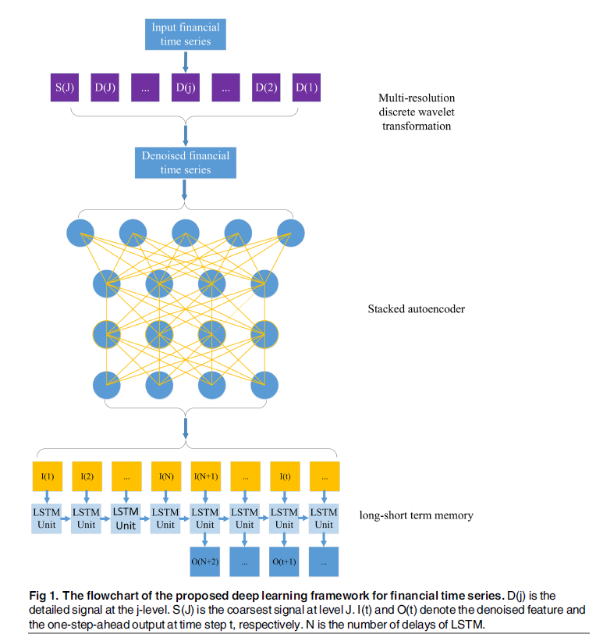
Framework

Slide 17
Stacked Auto-Encoders
The deep network is typically initialized by unsupervised layer-wise training and then tuned by supervised training with labels that can progressively generate more abstract and high-level features layer by layer.
Stacked autoencoders is constructed by stacking a sequence of single-layer AEs layer by layer .
Single layer AE is a three-layer neural network:
Input Layer - Hidden Layer - Reconstruction Layer.
The first layer and the third layer are the input layer and the reconstruction layer with k units, respectively.

Slide 18
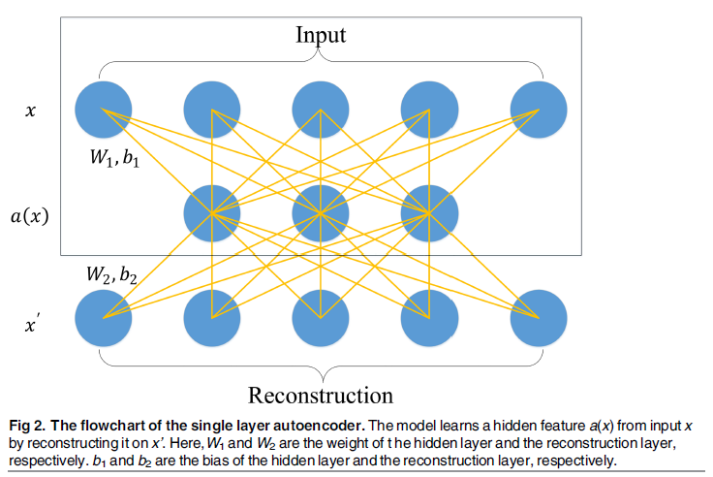
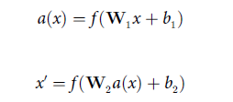
Stacked Auto-Encoders
结构：
目标：

Slide 19
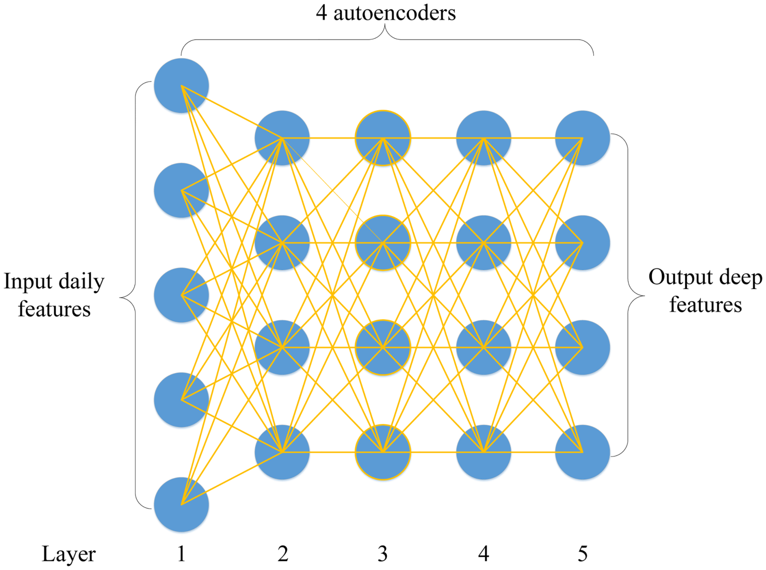
Stacked Auto-Encoders
模型架构的参考文献
Chen Y, Lin Z, Zhao X, Wang G, Gu Y. Deep Learning-Based Classification of Hyperspectral Data.
IEEE J Sel Top Appl Earth Observ Remote Sens. 2014; 7(6):2094±107.

Slide 20
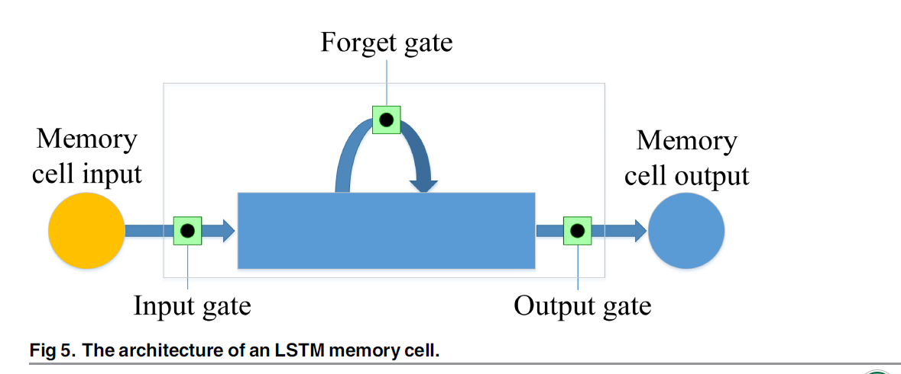
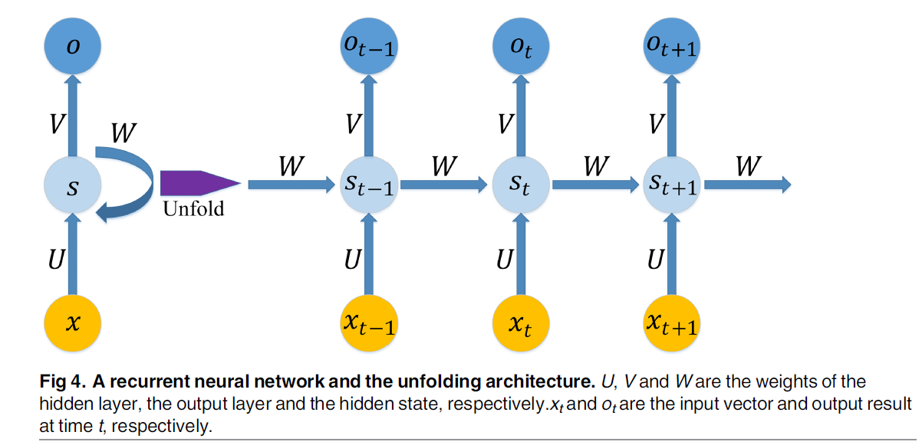
LSTM

Slide 21
Data descriptions
Testing the model in variant market conditions brings us the opportunity to solve the problem and shows us how robust the predictability of our model is.
Developing markets: CSI 300, Nifty 50
Developed market: S&P500 , DJIA index
Intermediate : Hang Seng index, Nikkei 225
Input variables.
Daily Trading Data: Open, High, Low, Close price, trading volume.
12 Technical Indicator:MACD,MA5/10,BOLL, etc …
Macroeconomic Variable: the exchange rate and the interest rate(利率).
Data resource:
WIND database、CSMAR database、Investing.com.

Slide 22
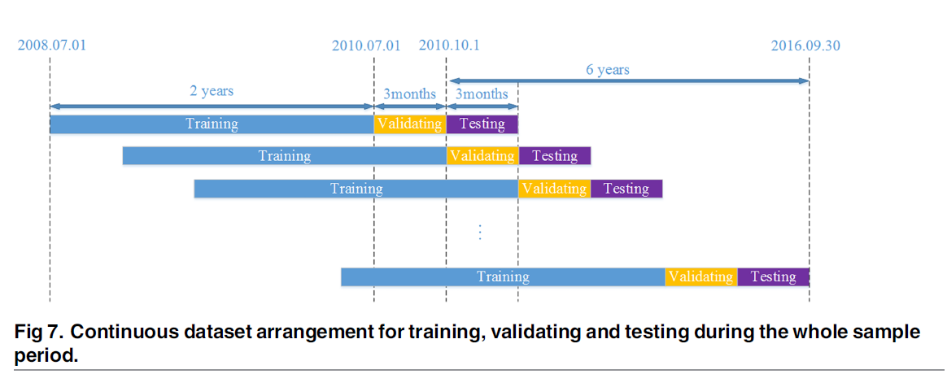
Experiment design

Slide 23
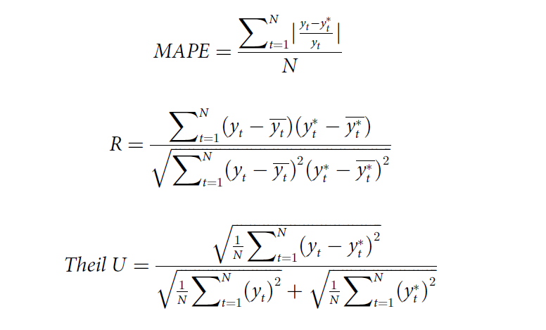
Experiment design
Predictive accuracy performance

Slide 24
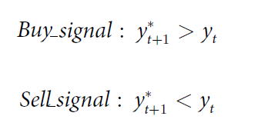
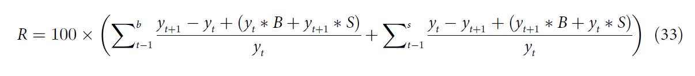
Experiment design
Profitability performance
The trading returns of each model will be compared against the returns of the buy-and-hold strategy. The unified cost in the spot market is 0.25% for buying and 0.45% for selling.

Slide 25
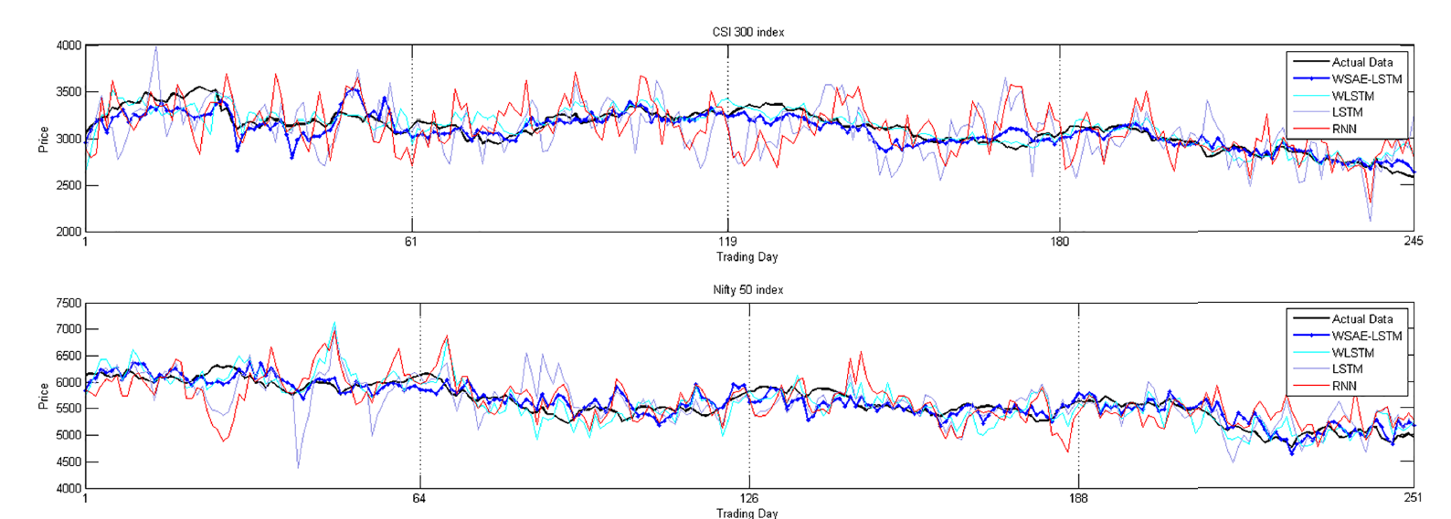
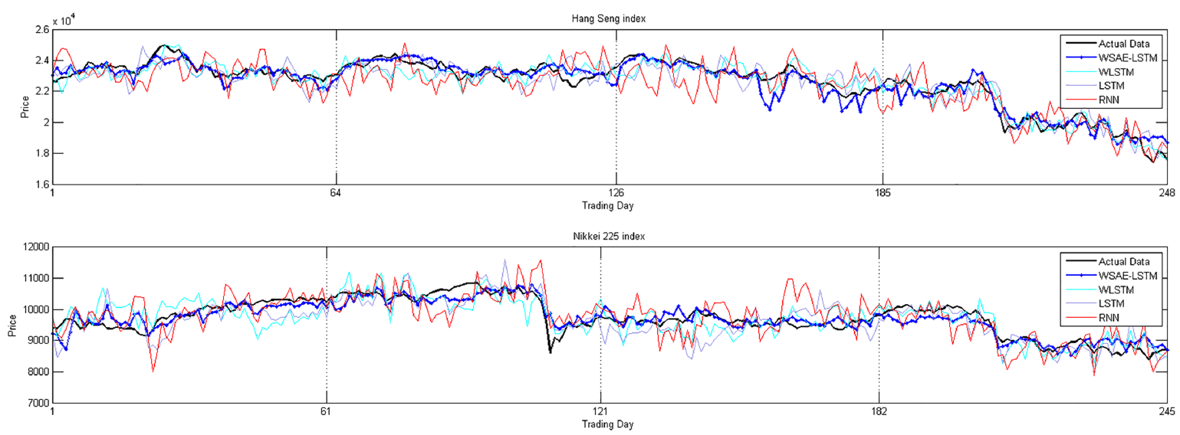
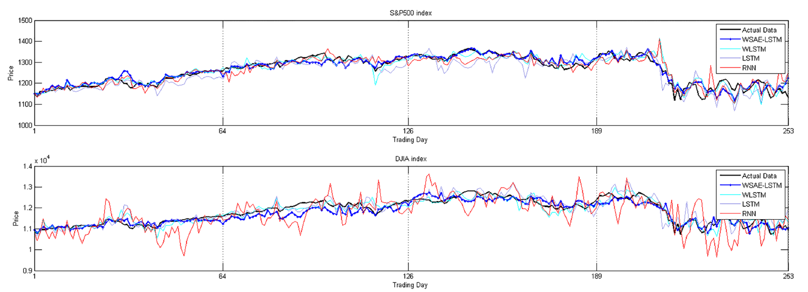
Results

Slide 26
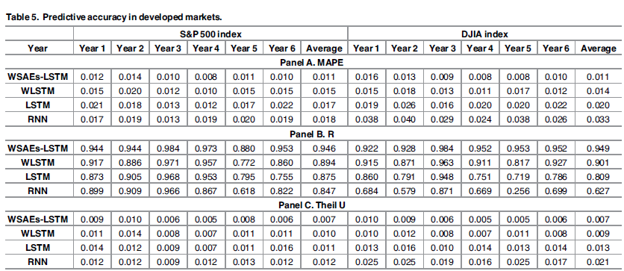
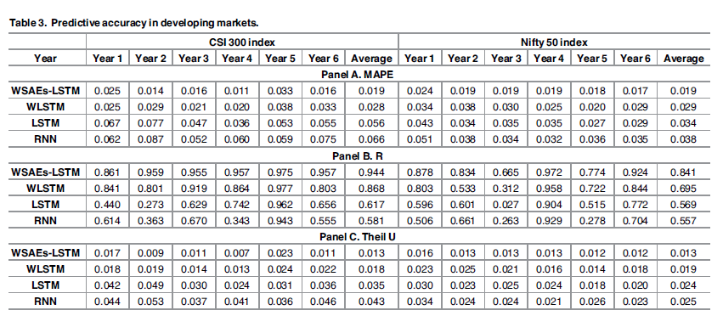
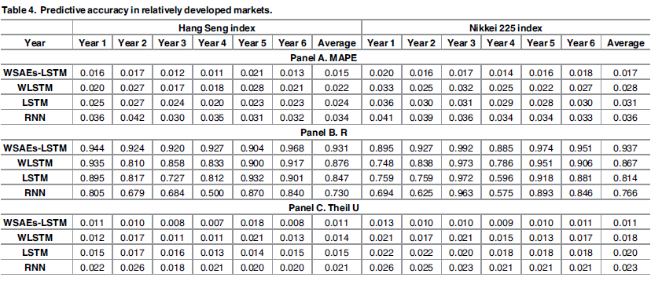
Results

Slide 27
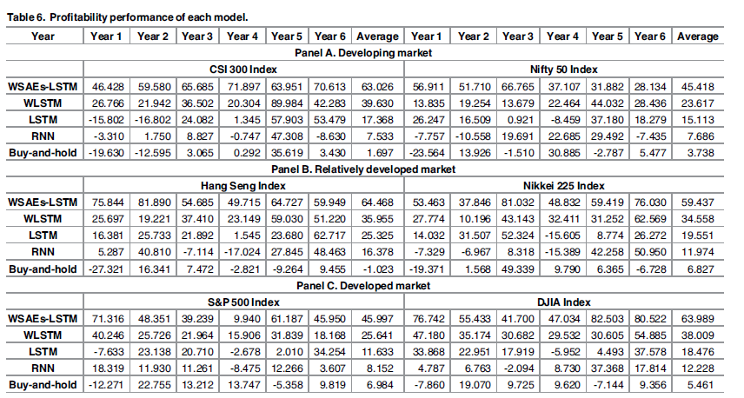
Results

